Slide 1
Data Collection and Analysis Area Measurement
How to measure the perimeter and area of an arbitrary closed shape?

Slide 2
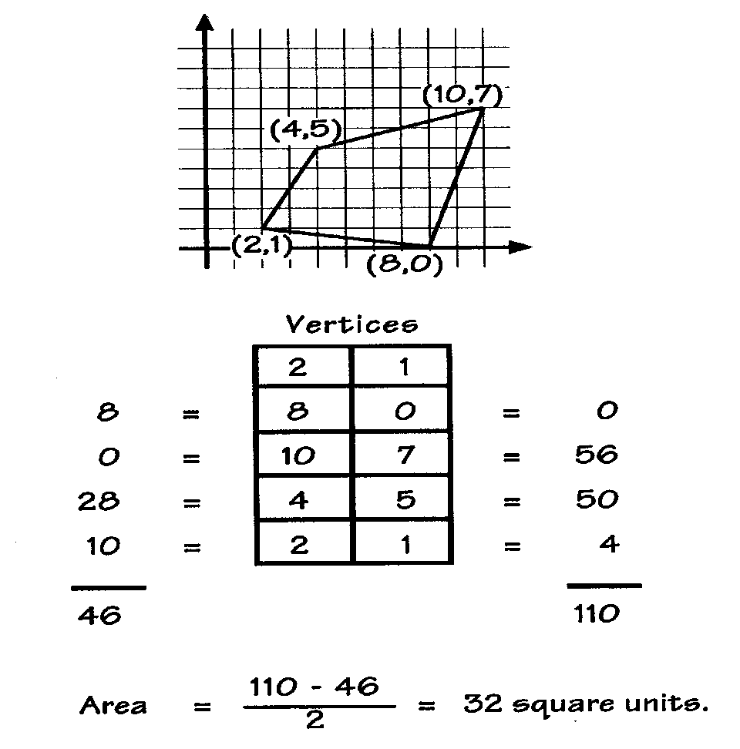
Data Collection and Analysis Area Measurement
How to measure the perimeter and area of an arbitrary closed shape?
Consider Descartes’ method:
INSTRUCTIONS
Beginning with any vertex, list the coordinates of the vertices in order, moving counter-clockwise around the polygon. List the first pair again at the end. Find the diagonal products from left to right. Find the diagonal products from right to left. Sum each column of products. Find their difference and divide by 2. This is the polygon’s area.
Could we do this by driving a robot around the shape?
From Historical Connections in Mathematics, Volume III, Area the Easy Way

Slide 3
Data Collection and Analysis Area Measurement
Need to generate (x, y) pairs as the robot follows the line around…
But unlike the plotted curve, the robot does not know what the next pair will be.
Need to find a way to remember the last point and calculate the next one.
Just a little trigonometry…
and a compass.
North
(X _{new}, Y _{new})
X _{new} = X _{old} + ΔX
Y _{new} = Y _{old} + ΔY
Heading
ΔY
ΔX = Dist *Sine (Hdg)
Distance
ΔY = Dist *Cosine (Hdg)
(X _{old}, Y _{old})
ΔX
Inspired by Area the Easy Way

Slide 4
Data Collection and Analysis Area Measurement
Need to generate (x, y) pairs as the robot follows the line around…
But unlike the plotted curve, the robot does not know what the next pair will be.
Need to find a way to remember the last point and calculate the next one.
Just a little trigonometry…
and a compass.
North
X _{new} = X _{old} + ΔX
Y _{new} = Y _{old} + ΔY
(X _{new}, Y _{new})
Heading
ΔY
ΔX = Dist *Sine (Hdg)
Distance
ΔY = Dist *Cosine (Hdg)
(X _{old}, Y _{old})
ΔX
Sine and cosine provide positive and negative factors that scale the sides of the right triangle.
Inspired by Area the Easy Way

Slide 5
Data Collection and Analysis Area Measurement
Show development of the path as the robot follows along the orange curve.
X _{new} = X _{old} + ΔX
Y _{new} = Y _{old} + ΔY
ΔX = Dist *Sine (Hdg)
ΔY = Dist *Cosine (Hdg)
Sine and cosine provide positive and negative factors that scale the sides of the right triangle.
Inspired by Area the Easy Way

Slide 6
Data Collection and Analysis Area Measurement
Show development of the path as the robot follows along the orange curve.
X _{new} = X _{old} + ΔX
Y _{new} = Y _{old} + ΔY
ΔX = Dist *Sine (Hdg)
ΔY = Dist *Cosine (Hdg)
ΔY
ΔX
Sine and cosine provide positive and negative factors that scale the sides of the right triangle.
Inspired by Area the Easy Way

Slide 7
Data Collection and Analysis Area Measurement
Example path showing generated (x, y) pairs as the robot follows the line around.
X _{new} = X _{old} + ΔX
Y _{new} = Y _{old} + ΔY
North
ΔX = Dist *Sine (Hdg)
ΔY = Dist *Cosine (Hdg)
(X₂, Y₂)
(X₁, Y₁)
ΔY
(X₀, Y₀)
ΔX
Sine and cosine provide positive and negative factors that scale the sides of the right triangle.
Inspired by Area the Easy Way

Slide 8
Data Collection and Analysis Area Measurement
Example path showing generated (x, y) pairs as the robot follows the line around.
X _{new} = X _{old} + ΔX
Y _{new} = Y _{old} + ΔY
North
ΔX = Dist *Sine (Hdg)
ΔY = Dist *Cosine (Hdg)
(X₂, Y₂)
(X₅, Y₅)
(X₁, Y₁)
ΔY
(X₃, Y₃)
(X₄, Y₄)
(X₀, Y₀)
ΔX
Sine and cosine provide positive and negative factors that scale the sides of the right triangle.
Inspired by Area the Easy Way

Slide 9
Data Collection and Analysis Area Measurement – two plots
North
X _{new} = X _{old} + ΔX
Y _{new} = Y _{old} + ΔY
Rectangle with Distance = 1 inch
Circle with Distance = 1 inch
(X _{new}, Y _{new})
Heading
ΔY
ΔX = Dist *Sine (Hdg)
Distance
ΔY = Dist *Cosine (Hdg)
(X _{old}, Y _{old})
ΔX
Inspired by Area the Easy Way

Slide 10
Data Collection and Analysis Area Measurement – two plots
Rectangle with Distance = 1 inch
Circle with Distance = 1 inch
Red arrows indicate error accumulated through each run.
Inspired by Area the Easy Way

Slide 11
Data Collection and Analysis Area Measurement

