Slide 1
NXT-G – Data Collection and Analysis Pendulum Motion

Slide 2
Data Logging
Pendulum Data Logging Program

Slide 3
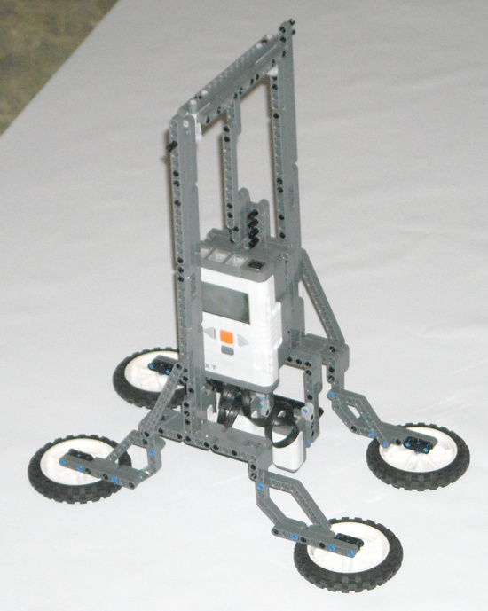
Application
Measuring period of a pendulum common exercise for students
Period = 2π √(L/g)
84 ½ inches
12 ½ inches
Notes:
Exercise taken from Physics with Robotics by William Church, Tony Ford, and Natasha Perova.
Section 4.6 Swinging with Gravity
http://www.physicswithrobotics.com/Home

Slide 4
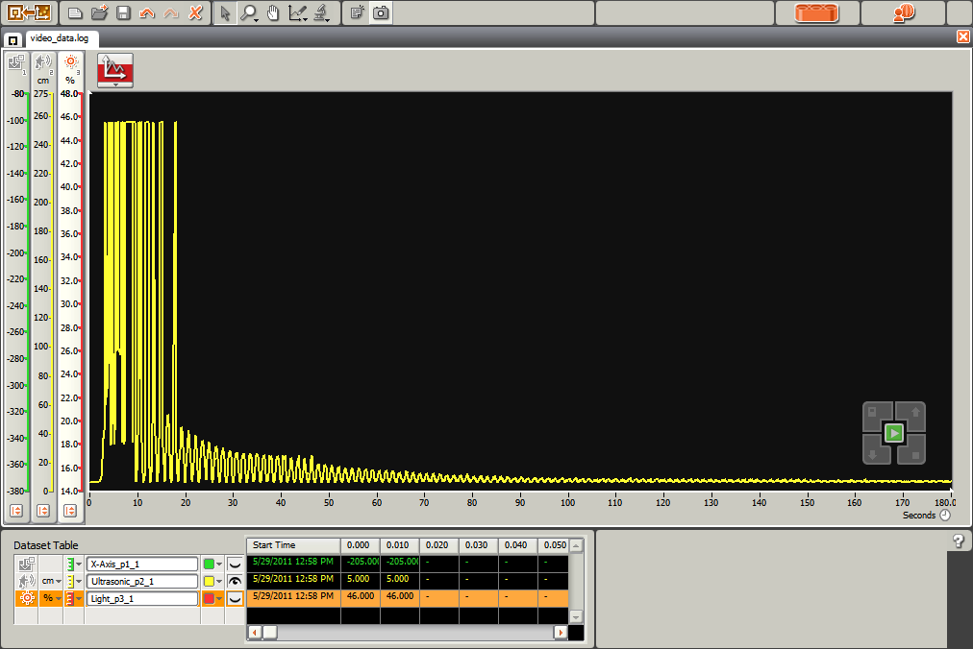
Pendulum Data
84 ½ inches
Ultrasonic sensor
Notes:
Exercise taken from Physics with Robotics by William Church, Tony Ford, and Natasha Perova.
Section 4.6 Swinging with Gravity
http://www.physicswithrobotics.com/Home

Slide 5
Pendulum Data
84 ½ inches
Ultrasonic sensor
Notes:
Exercise taken from Physics with Robotics by William Church, Tony Ford, and Natasha Perova.
Section 4.6 Swinging with Gravity
http://www.physicswithrobotics.com/Home

Slide 6
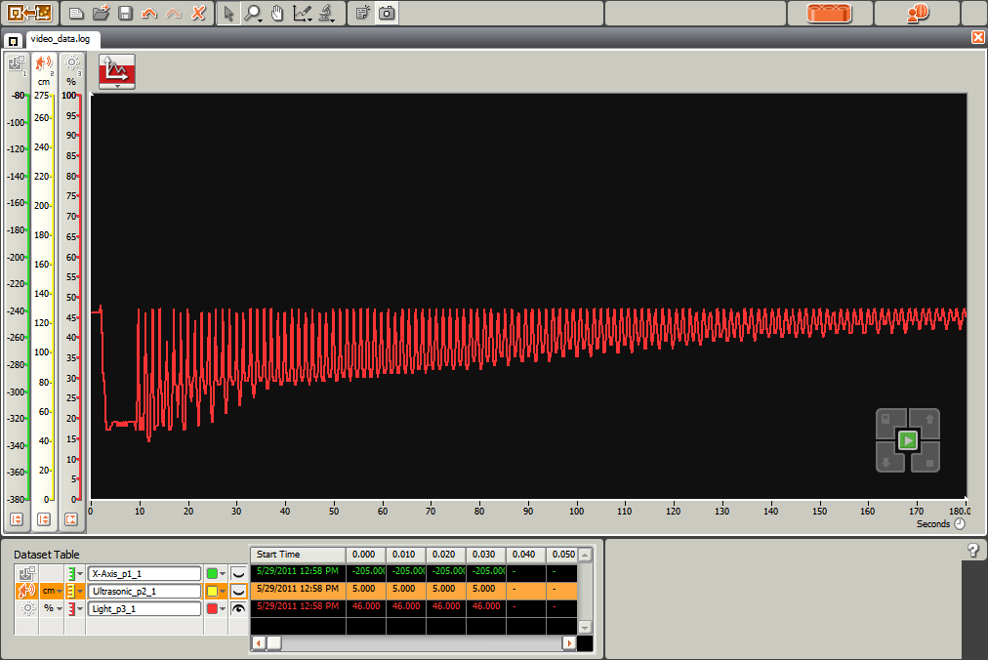
Pendulum Data
84 ½ inches
Light sensor
Notes:
Exercise taken from Physics with Robotics by William Church, Tony Ford, and Natasha Perova.
Section 4.6 Swinging with Gravity
http://www.physicswithrobotics.com/Home

Slide 7
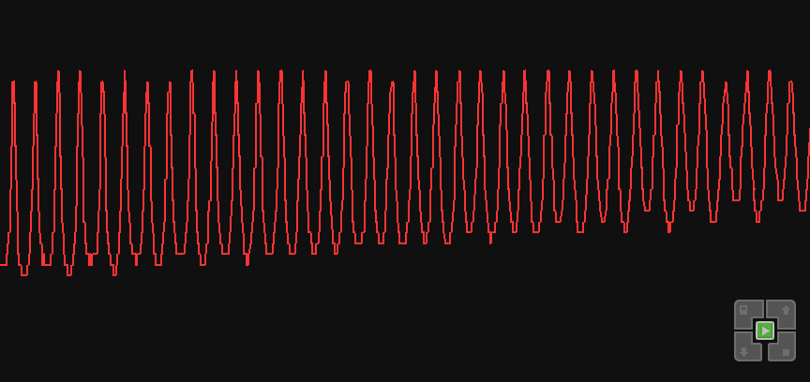
Pendulum Data
84 ½ inches
Light sensor
Notes:
Exercise taken from Physics with Robotics by William Church, Tony Ford, and Natasha Perova.
Section 4.6 Swinging with Gravity
http://www.physicswithrobotics.com/Home

Slide 8
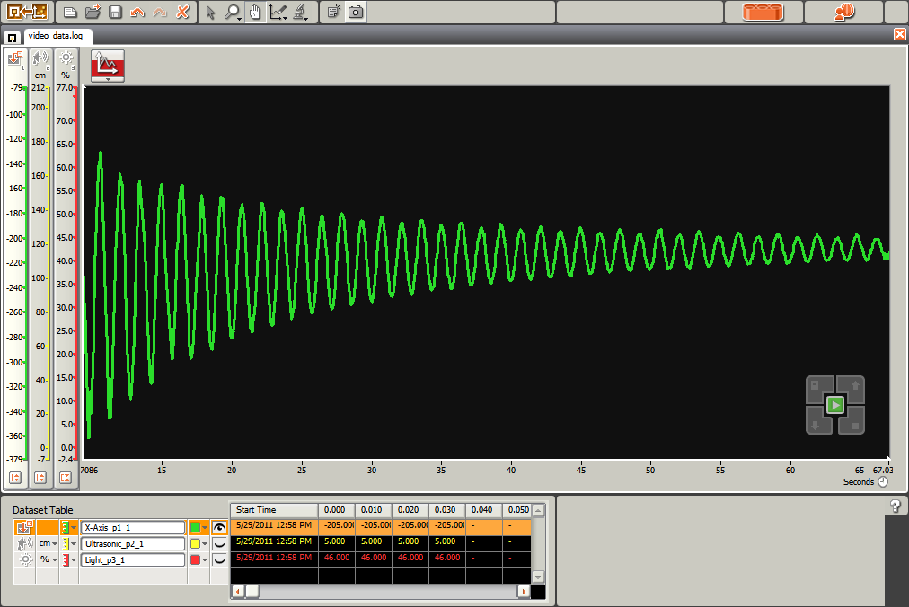
Pendulum Data
84 ½ inches
Acceleration sensor
Notes:
Exercise taken from Physics with Robotics by William Church, Tony Ford, and Natasha Perova.
Section 4.6 Swinging with Gravity
http://www.physicswithrobotics.com/Home
The Acceleration sensor block measures the three axes of acceleration, x, y and z. It returns the readings as signed values ranging from -400 to +400 thus the scale factor is approximately 200 counts per g, so the sensor can measure +/- 2g. Using data wires, it can send out the x, y and z values and a logic signal (true/false) based on whether the x value is above or below a trigger value.

Slide 9
Pendulum Data
84 ½ inches
Acceleration sensor
Notes:
Exercise taken from Physics with Robotics by William Church, Tony Ford, and Natasha Perova.
Section 4.6 Swinging with Gravity
http://www.physicswithrobotics.com/Home
The Acceleration sensor block measures the three axes of acceleration, x, y and z. It returns the readings as signed values ranging from -400 to +400 thus the scale factor is approximately 200 counts per g, so the sensor can measure +/- 2g. Using data wires, it can send out the x, y and z values and a logic signal (true/false) based on whether the x value is above or below a trigger value.

Slide 10
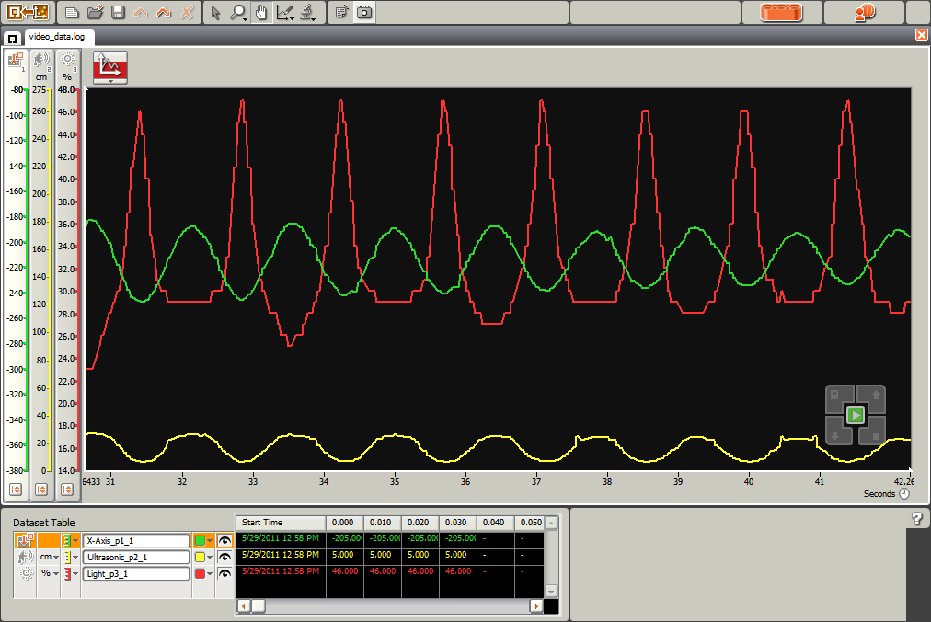
Pendulum Relationships
Notes:
Exercise taken from Physics with Robotics by William Church, Tony Ford, and Natasha Perova.
Section 4.6 Swinging with Gravity
http://www.physicswithrobotics.com/Home
The Acceleration sensor block measures the three axes of acceleration, x, y and z. It returns the readings as signed values ranging from -400 to +400 thus the scale factor is approximately 200 counts per g, so the sensor can measure +/- 2g. Using data wires, it can send out the x, y and z values and a logic signal (true/false) based on whether the x value is above or below a trigger value.

Slide 11
Pendulum Relationships
Maximum Light
Maximum Negative Acceleration
Minimum Ultrasonic Range
Notes:
Exercise taken from Physics with Robotics by William Church, Tony Ford, and Natasha Perova.
Section 4.6 Swinging with Gravity
http://www.physicswithrobotics.com/Home
The Acceleration sensor block measures the three axes of acceleration, x, y and z. It returns the readings as signed values ranging from -400 to +400 thus the scale factor is approximately 200 counts per g, so the sensor can measure +/- 2g. Using data wires, it can send out the x, y and z values and a logic signal (true/false) based on whether the x value is above or below a trigger value.

Slide 12
Math Excursion
Lower the sample
Frequency to
Something near the
Pendulum period.
Pendulum Program

Slide 13
NXT-G – Data Collection and Analysis Pendulum Motion

