Slide 1
Using the NXT Light Sensor

Slide 2
Connect One Light Sensor – 1
From My Files
use Left / Right NXT buttons
and get to View menu and push Orange button.
From View menu
use Left / Right NXT buttons
and get to Reflected Light menu.
From Reflected Light menu
use Left / Right NXT buttons to find correct port
and push the Orange button.

Slide 3
Connect One Light Sensor - 2
Discuss types of readings
Example – Compare the floor with the blue tape

Slide 4
Light Sensor Practice 1
Make the robot move forward and stop on the blue tape line.

Slide 5
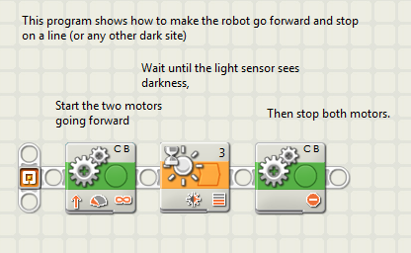
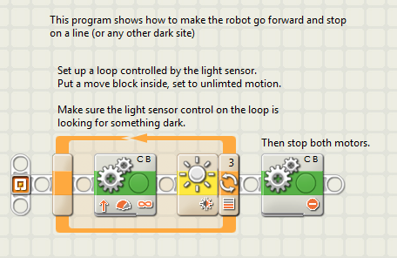
Light Sensor Practice 1
Here are a couple of methods, both equally right

Slide 6
Light Sensor Practice 2
Make the robot go back and forth between two blue lines of tape.
Whether to make the robot back up or turn around is the programmer’s choice.

Slide 7
Help the Robot Escape a Box - 1
Could we use the light sensor and our turns to help the robot escape from a mostly closed box?
Set up a pattern of blue tape that looks something like this:

Slide 8
Help the Robot Escape a Box - 2
Write a program so the robot:
Moves Forward
Finds the blue border,
Turns away
And repeats the process until it escapes out the opening
From starting anywhere inside the box.

Slide 9
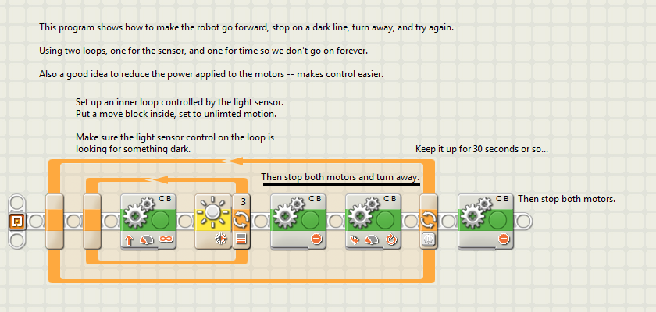
Help the Robot Escape a Box - 3
Here’s a program that can work, many others will, too.

Slide 10
Escaping the infinite Spirograph… 1
Some boxes and programmed turn combinations will make the robot get stuck in a pattern: an infinite Spirograph.
To get out of this situation:
Connect a random value to the steering command for the robot’s turn away from the blue line.
This will make each turn different. It will result in some missed opportunities, but also avoids repeated missed escape opportunities.

Slide 11
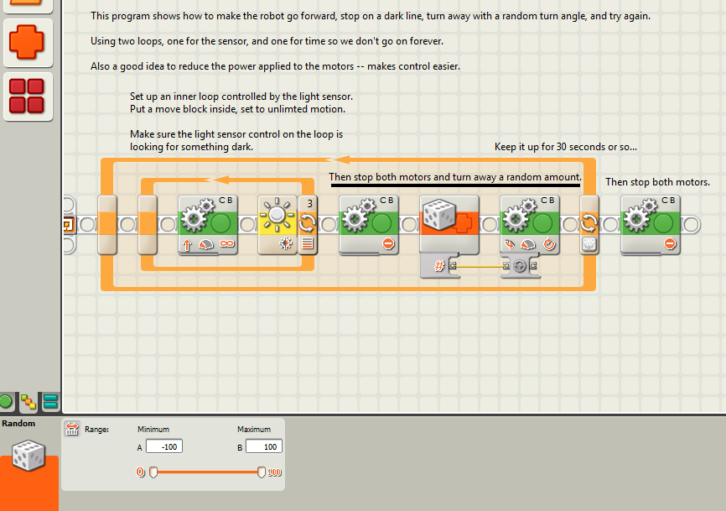
Escaping the infinite Spirograph… 2
random control added to the turn in this program.

Slide 12
Lines as Guides
How might we use a line to make the robot go where we want it to?

Slide 13
Lines as Guides
How might we use a line to make the robot go where we want it to?
Need to develop some method to select one action from several options.

Slide 14
New Tool for Decisions

Slide 15
New Tool for Decisions
This view is good for
Either / Or
decisions

Slide 16
New Tool for Decisions
This view is good for
Multiple Choice

Slide 17
More Decisions

Slide 18
Body Forward mat

Slide 19
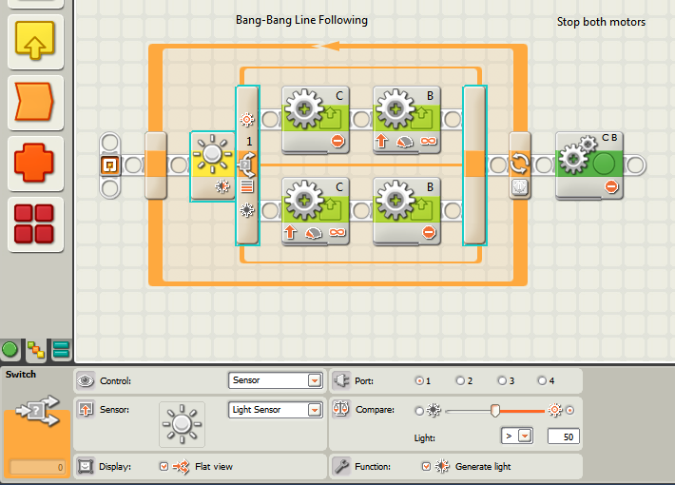
Line Following – one approach

Slide 20
Smooth it Out
Once line following has been attained and the robots are waddling around the room on their blue lines, challenge the students to smooth out the robot’s motion.
Hint:
motor power and braking decisions might make a difference.

Slide 21
Audible Feedback -1
To make line following more interesting:
connect a data line from the light sensor’s output block to the volume control of a sound block
Set the sound block to play a tone for about 1/100th of a second
In both sides of the bang bang line following program
Fair warning… this could get loud.

Slide 22
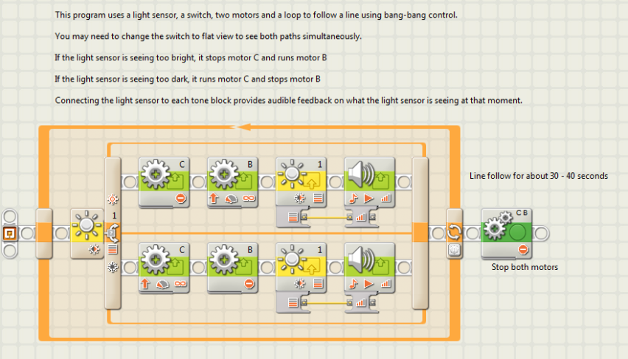
Audible Feedback -2
Here’s an example

Slide 23
Line Following – one approach
The value we choose for the decision is called the Threshold Value.
In this case it = 50

Slide 24
Another Approach…
Instead of turning the motors on or off to move along the line, could we make the robot move forward along the line?
And correct for errors if it drifted off the line?
Perfectly on line → both motors run at 50% power
Notes:
Introducing the idea of proportional line following.

Slide 25
Another Approach…
As robot drifts off the line → run motors at different powers to drive it back to the line’s edge
Instead of turning the motors on or off to move along the line, could we make the robot move forward along the line?
And correct for errors if it drifted off the line?
Perfectly on line → both motors run at 50% power
Notes:
Introducing the idea of proportional line following.

Slide 26
Take a closer look
Edge of line should give a light sensor reading of about 50
Light sensor = 50

Slide 27
Take a closer look
Threshold Value = 50
Actual Values
Light sensor = 70
Light sensor = 50
Light sensor = 30

Slide 28
Define the Error
Error = Threshold - Actual
Threshold Value = 50
Actual Values
Error = - 20
Light sensor = 70
Error = 0
Light sensor = 50
Error = 20
Light sensor = 30

Slide 29
How to control the robot’s motors
Start with motors going forward at some power level
Watch the light sensor values
Measure Error = Threshold – Actual
Raise or Reduce each Motor’s Power based on the Error
Threshold Value = 50
Actual Values
Light sensor = 70
Error = -20
Light sensor = 50
Error = 0
Light sensor = 30
Error = 20

Slide 30
Pseudocode – One Approach
Define Variables
MotorPower = 50%
Threshold = 50
Error = 0
Start Loop
Error =
Threshold – Actual
LeftMotor =
MotorPower – Error
RightMotor =
MotorPower + Error
End Loop
Desired power = 50%
Threshold Value = 50
Actual Values
Light sensor = 70
Error = -20
Light sensor = 50
Error = 0
Light sensor = 30
Error = 20

Slide 31
Sample Proportional Program

Slide 32
Pseudocode – Stronger
Improve Responsiveness by Multiplying the Error
Define Variables
MotorPower = 50%
Threshold = 50
Error = 0
Gain (Kp) = 1 (use 1 at first to make sure we did not break
the program)
Start Loop
Error = Threshold – Actual
LeftMotor = MotorPower – (Error x Gain)
RightMotor = MotorPower + (Error x Gain)
End Loop
Threshold Value = 50
Actual Values
Light sensor = 70
Error = -20
Light sensor = 50
Error = 0
Light sensor = 30
Error = 20

Slide 33
Sample Proportional with Gain Program

Slide 34
Another Perspective
↑↓
Error ↑ means
RightMotor Power ↑
And
LeftMotor Power ↓
Forcing the robot back towards the line’s edge while still going forward
↑
↓

Slide 35
Another Perspective
↑↓
Error ↓ means
RightMotor Power ↓
And
LeftMotor Power ↑
Forcing the robot back towards the line’s edge while still going forward
↑
↓

Slide 36
Other Improvements
Beyond using proportional control can also:
Add the old Error and new Error each loop and use that growth to control the motor power levels
This tells how far off the line the robot has drifted (integration)
Watch the Error change between each loop and use that to control motor power levels
This tells how fast the error is being corrected (differentiation)

Slide 37
More Complex Line Following
Learn how to combine all three methods in Mr. Jim Sluka's Tutorial on PID Controller for Mindstorms
http://www.inpharmix.com/jps/PID_Controller_For_Lego_Mindstorms_Robots.html
PID = Proportional, Integral, Derivative

Slide 38
Use More than One Light Sensor
Follow the line with one sensor
Use the other for control

Slide 39
Use More than One Light Sensor
Stop when this one reaches the line

Slide 40
Example

Slide 41
Using the NXT Light Sensor

